Slide 1
ASUS Demo App - Introduction
ASUS Demo App Purpose | In-Store Introduction | Language Support List

Slide 2
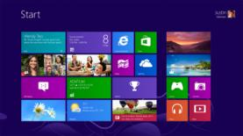
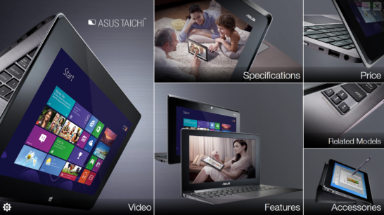
ASUS Demo App Purpose
Demo screen only shows Window 8 interface or product video
Every Windows 8 display shows the same image
More interactive user experience
FAB can be explained in more detail by videos and images
More eye-catching
Before
NOW

Slide 3
How Does It Work after Initiation
Screensaver display
(video shown at random)
Working demo unit displays screensaver automatically
When users touch the screen
Screensaver will auto-play in loop after idling for
60 seconds with both screens on
Display interactive Demo App
Users experience ASUS TAICHI in more detail
Exit ASUS Demo App
Touch and experience
ASUS TAICHI
Users can experience Windows 8 beyond ASUS Demo App

Slide 4
ASUS Demo App - Installation SOP

Slide 5
ASUS Demo App Activate SOP
Step 1
Download the file
Step 2
Install the file on an ASUS TAICHI demo unit
Step 3
Duplicate Content (images/videos) to demo units
Step 4
Set up (model names and referral information)

Slide 6
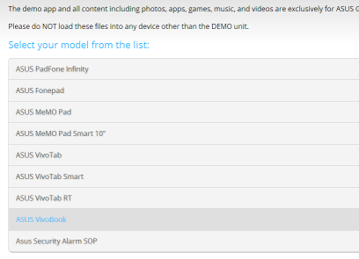
Installation SOP - Download
Step 1
Download the Demo App for promoters from 2 sources
ASUS DEMO Program Resource Site
Channel Site
http://www.asus.com/microsite/demo/#/list
Marketing Resource → Products → Notebooks → TAICHI 21
OR
Marketing Resource → Products → Notebooks → TAICHI 31
OR
Activate after July 5th, 2013

Slide 7
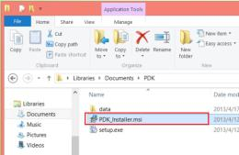
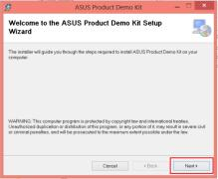
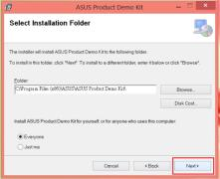
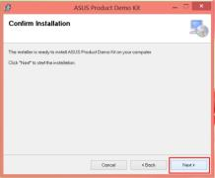
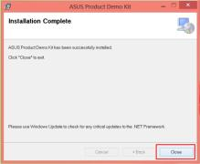
Installation SOP – Install APP
Step 2
1
Open PDK file
2
Select “PDK_Installer.msi”
→ Double click to setup
3
Press “Next”
4
Press “Next”
5
Press “Next”
6
Press “Next”
7
Press “Close”

Slide 8
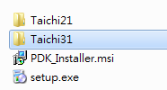
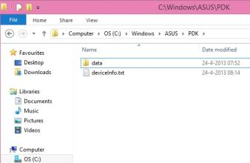
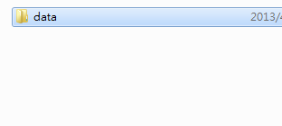
Installation SOP – Install Content
Step 3
1
Open PDK file
2
Open the folder based on machine model
3
Duplicate the folder named “data” to “C:\Windows\ASUS\PDK”
( Route: C drive -> Windows Folder -> ASUS Folder -> PDK Folder )
Copy

Slide 9
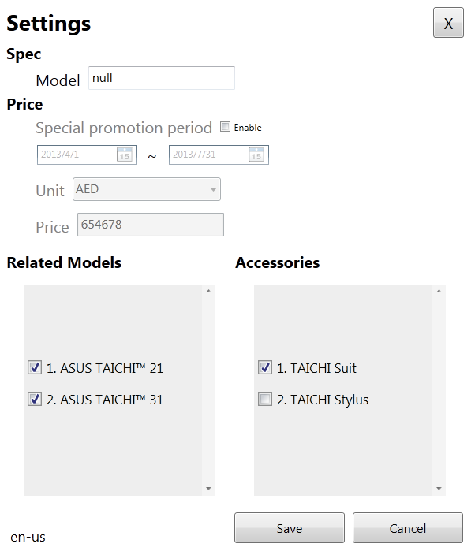
Active Demo App - Set Up
Step 4
1
2
4
Click “ASUS Demo App” icon on desktop
Press “Settings”
→Customize Info:
Model / Price / Accessories /Related Models /
3
Password: “8777”

Slide 10
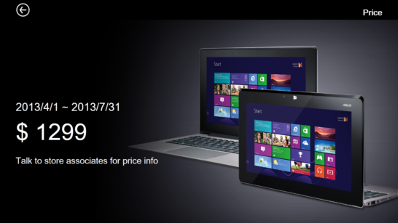
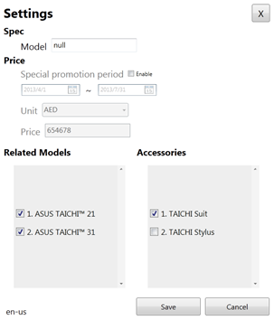
Overview | Videos | Specs | Features | Price | Related Models | Accessories
Set Up – Price Info
Price info within assigned period can be customized on “settings” page

Slide 11
Overview | Videos | Specs | Features | Price | Related Models | Accessories
Set Up – Model Info
Select models at the “settings” page

Slide 12
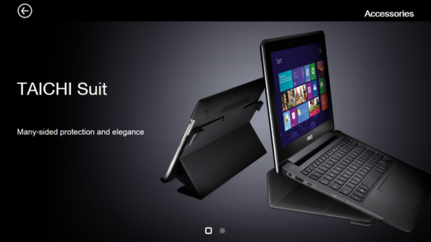
Overview | Videos | Specs | Features | Price | Related Models | Accessories
Set Up – Accessory Info
Select accessory models on “settings” page

Slide 13
04. ASUS Demo App Content
Overview | Videos | Specs| Features | Price | Related Models | Accessories

Slide 14
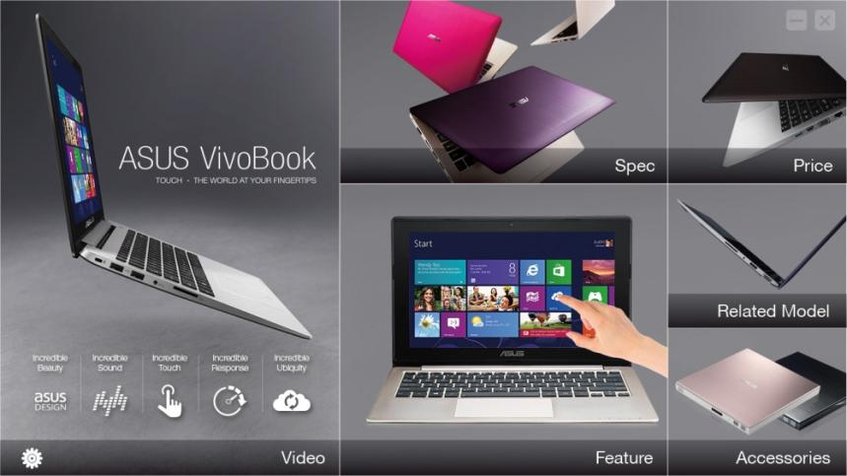
Overview | Videos | Specs | Features | Price | Related Models | Accessories
Overview

Slide 15
Overview | Videos | Specs | Features | Price | Related Models | Accessories
1. Videos
Different scenarios with ASUS TAICHI in one’ daily life are well elaborated each episode of 1 min-long.

Slide 16
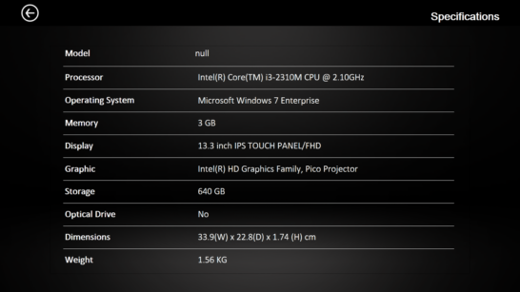
Overview | Videos | Specs | Features | Price | Related Models | Accessories
2.Specs
Model name can be customized at the “settings” page

Slide 17
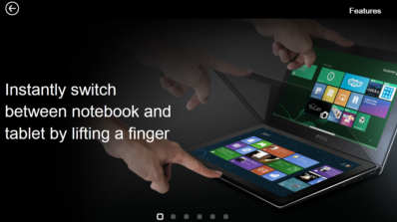
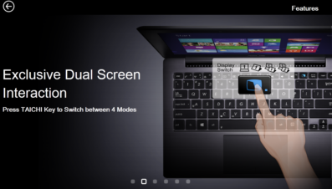
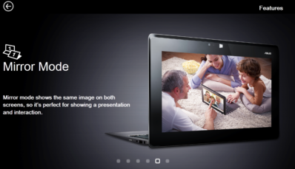
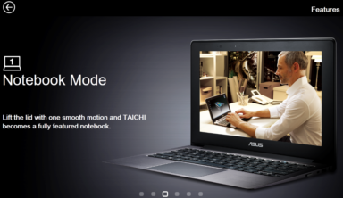
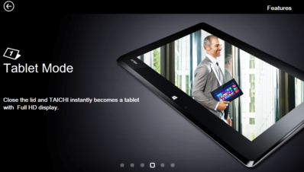
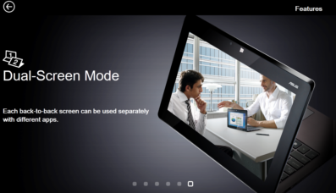
Overview | Videos | Specs | Features | Price | Related Models | Accessories
3. Features
Illustrate unique form factor and switching between 4 modes with exclusive TAICHI key

Slide 18
Overview | Videos | Specs | Features | Price | Related Models | Accessories
4. Price
Price info within assigned period can be customized on “settings” page

Slide 19
Overview | Videos | Specs | Features | Price | Related Models | Accessories
5. Related Models
Select models at the “settings” page

Slide 20
Overview | Videos | Specs | Features | Price | Related Models | Accessories
6. Accessories
Select accessory models on “settings” page

Slide 21
FAQ

Slide 22
FAQ
Q1. Does the ASUS Demo App apply to all ASUS notebooks?
All information and content in this app is tailor-made for ASUS TAICHI series .
Q2. Which models are suitable for demo units?
Entire ASUS TAICHI series, including TAICHI 21and TAICH 31.
Q3. How many languages does the app support?
A. We’ve implemented this app in English only at this stage.

Slide 23
FAQ
Q4. Do we have to keep demo units online?
A. No, all data and information is pre-installed and ready. ASUS Demo App doesn’t require an internet connection while running.
Q5. What’s the password for this app?
A. 8777
Q6. When does the screen saver start playing?
A. It launches automatically if the demo unit is idle for 60 seconds with both screen on. (Mirror mode)

Slide 24
THANK YOU
Please contact ASUS for further assistance

